Slide 1
Attention is not Explanation
NAACL
Sarthak Jain, Byron C. Wallace
Tracy Pan

Slide 2

Abstract vs Attention is all you Need
Our findings show that standard attention modules do not provide meaningful explanations and should not be treated as though they do.

Slide 3
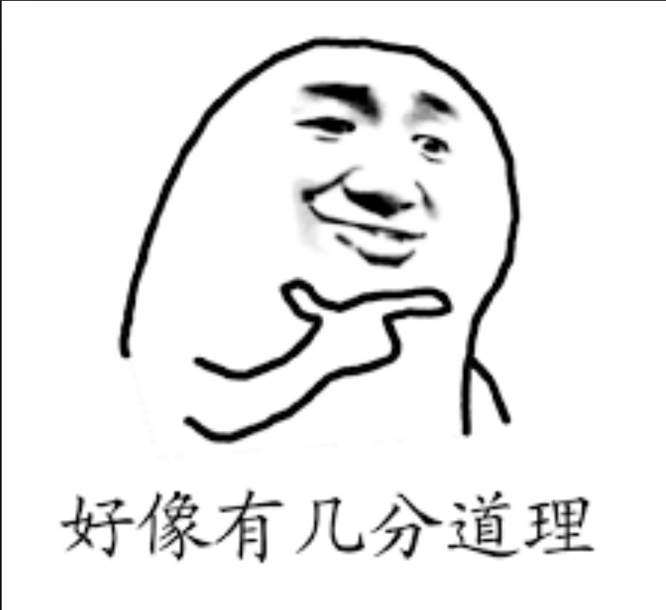
Introduction and Motivation
Li et al. (2016) summarized this commonly held view in NLP: “Attention provides an important way to explain the workings of neural models".
(i) Attention weights should correlate with feature importance measures (e.g., gradient-based measures);
(ii) Alternative (or counterfactual) attention weight configurations ought to yield corresponding changes in prediction (and if they do not then are equally plausible as explanations).

Slide 4
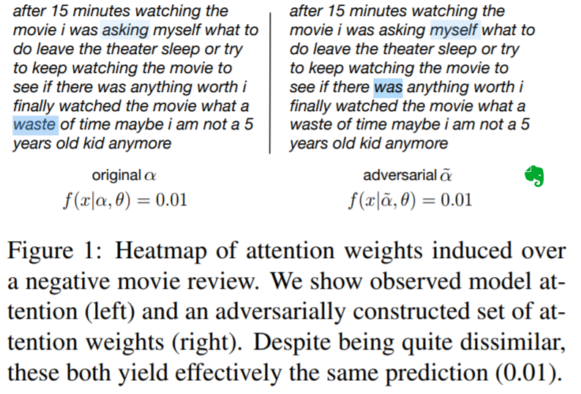
Introduction and Motivation
(1) Only weakly and inconsistently
(2) No; it is very often possible to construct adversarial attention distributions that yield effectively equivalent predictions as when using the originally induced attention weights, despite attending to entirely different input features.
Even more strikingly, randomly permuting attention weights often induces only minimal changes in output.

Slide 5

Introduction and Motivation
We report that neither property is consistently observed by a BiLSTM with a standard attention mechanism in the context of text classification, question answering (QA), and Natural Language Inference (NLI) tasks.

Slide 6
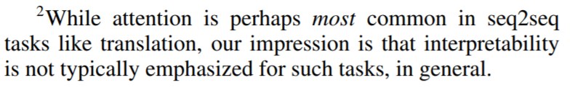
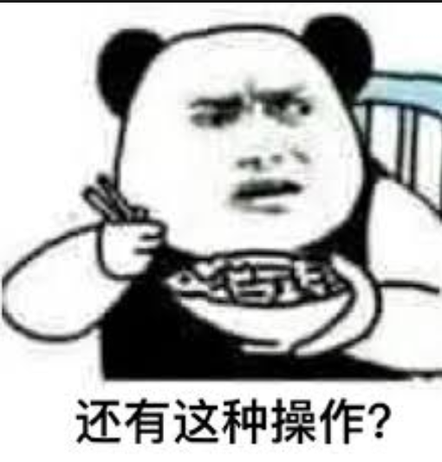
Preliminaries and Assumptions
Exemplar NLP tasks: classification, natural language inference (NLI), and question answering
Model: BiLstm +att

Slide 7
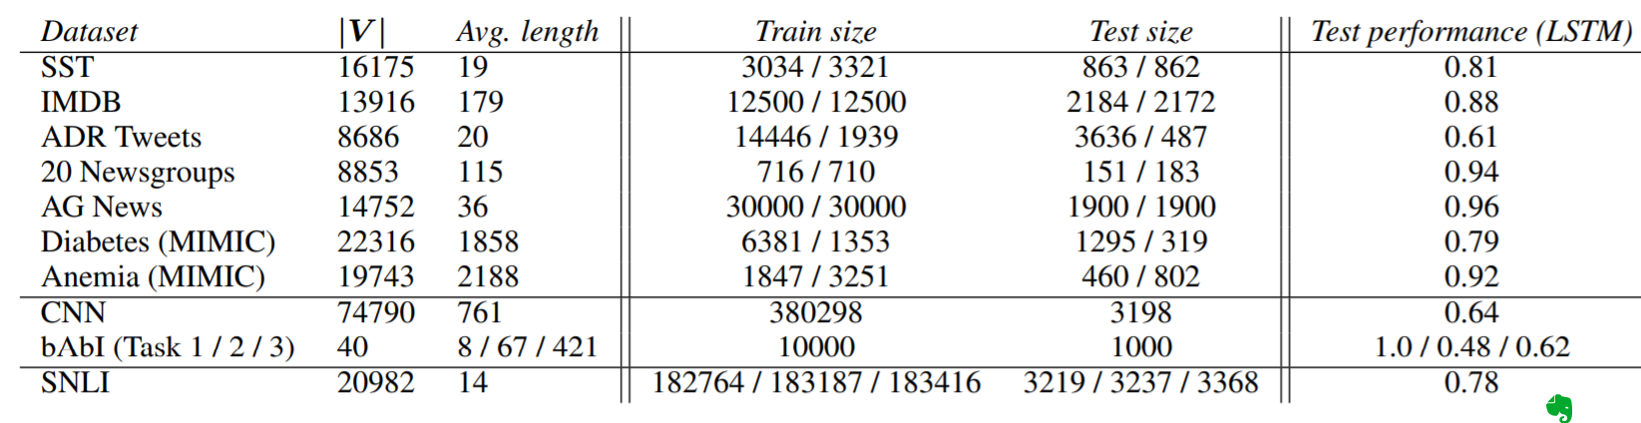
Datasets and Tasks
binary text classification, QA, NLI

Slide 8
Experiments
Specifically we measure correlations between attention and:
(1) gradient based measures of feature importance (τg)
(2) differences in model output induced by leaving features out (τloo).
我压根没看懂这两种方法。。具体介绍在另一篇论文，但是和其他人交流后大家都说没看懂其实没关系。。
大概应该是通过种种方法改变数据集的某个feature, 观察attention的变化，再具体的我也搞不懂了。。

Slide 9
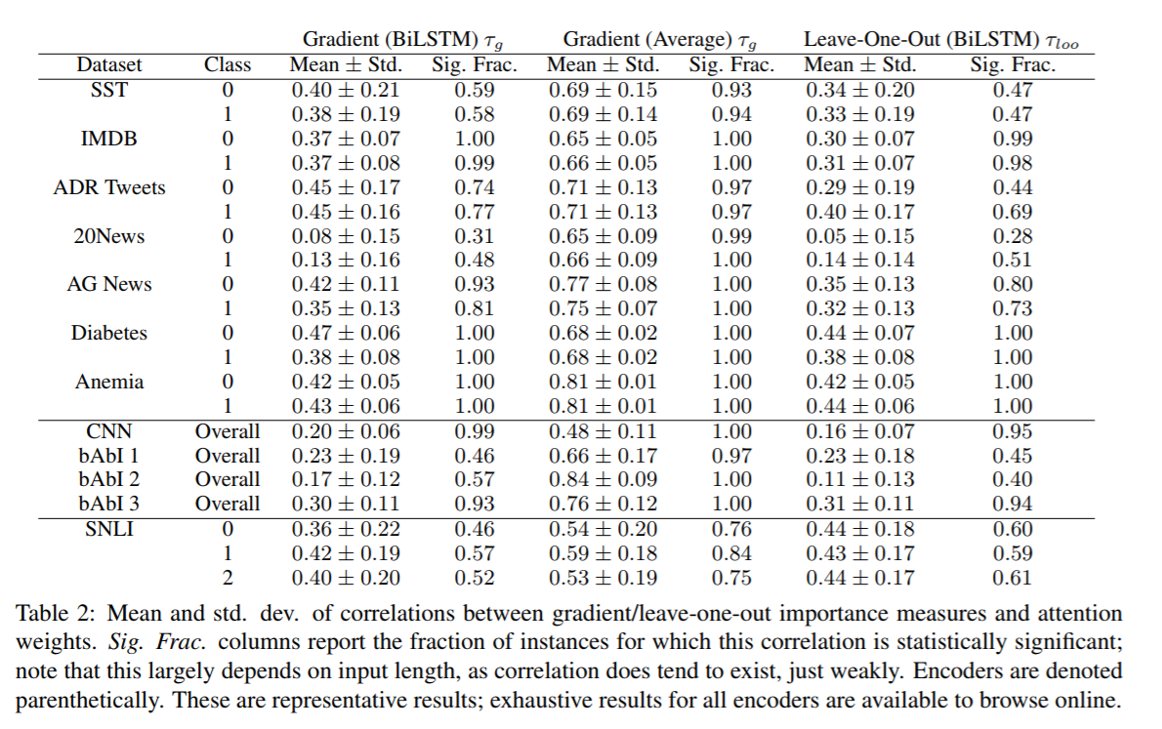
Experiments

Slide 10
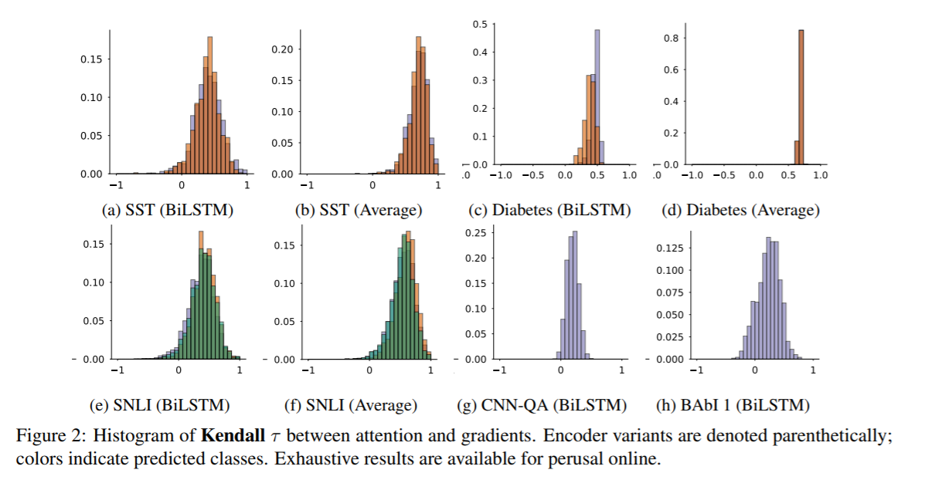
Experiments
Orange: positive ,purple :negative
For SNLI, purple, orange, green, code for neutral, contradiction and entailment, respectively

Slide 11

Experiments
In general, observed correlations are modest (recall that a value of 0 indicates no correspondence, while 1 implies perfect concordance) for the BiLSTM model. The centrality of observed densities hovers around or below 0.5 in most of the corpora considered

Slide 12
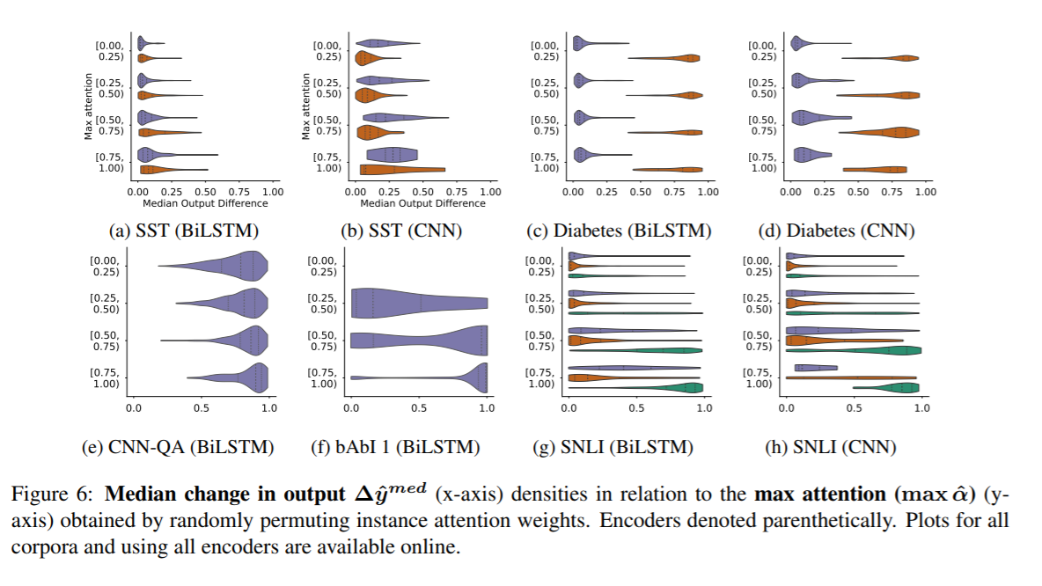
Experiments
First, we simply scramble the original attention weights αˆ, re-assigning each value to an arbitrary, randomly sampled index (input feature)the corpora considered

Slide 13
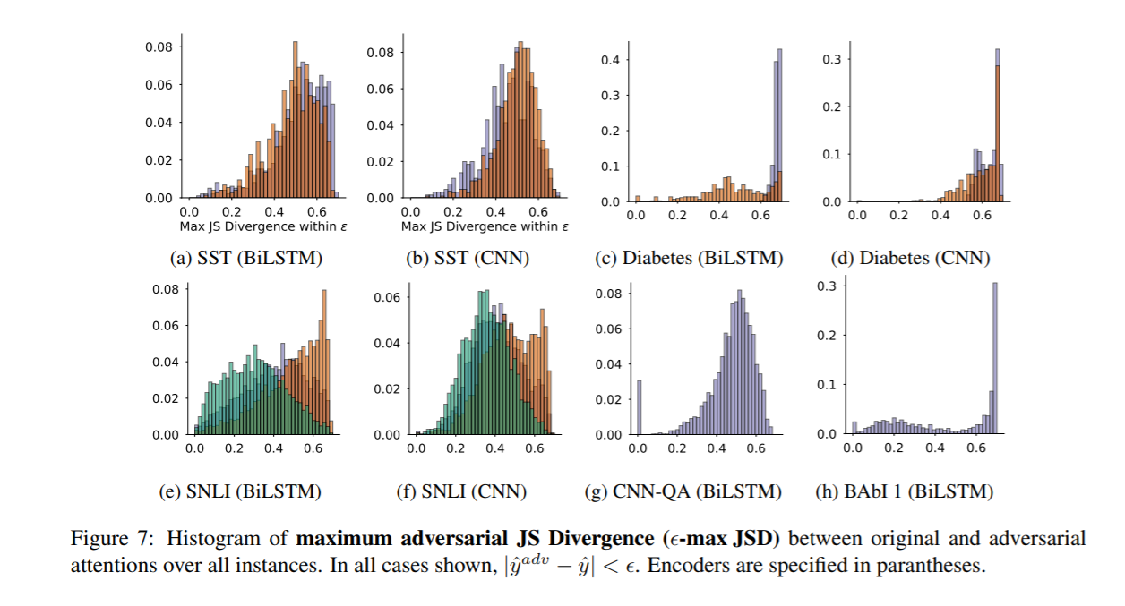
Experiments
Second, we generate an adversarial attention distribution: this is a set of attention weights that is maximally distinct from αˆ but that nonetheless yields an equivalent prediction

Slide 14

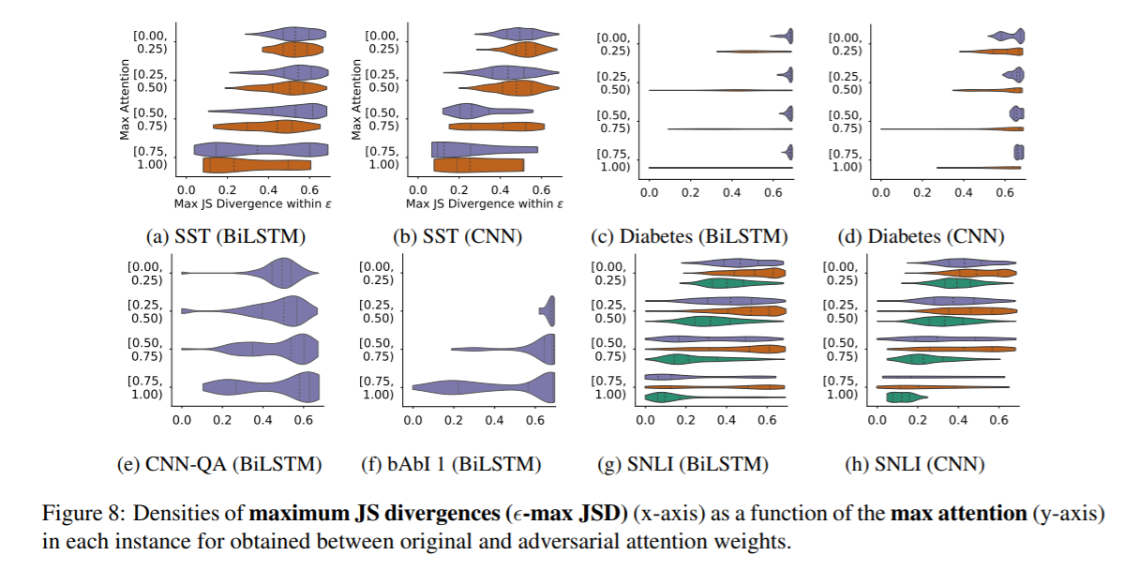
Experiments

Slide 15
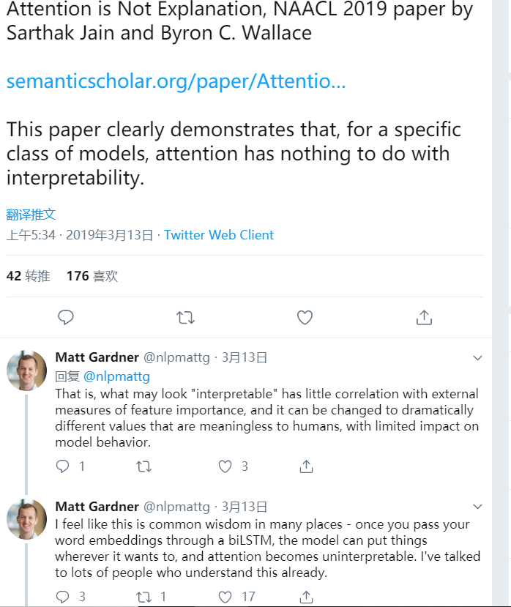


Slide 16
Attention is not not Explanation
Briefly, my main points are : Explanation can mean different things, and J&W are not clear on which interpretation they wish to disassociate from attention models;
Their first empirical study, a correlation-based analysis of attention scores, is neither sufficient to advance the claim nor convincing in its results;
Their second study, an attention-distribution manipulation experiment, is orthogonal to the claim, and designed with such a high degree of freedom, that its results have little to no meaning.
I write this critique in the hopes that future work treats the paper with caution, not taking the (admittedly catchy) title for its word. Attention Might Still Be Explanation.
https://medium.com/@yuvalpinter/attention-is-not-not-explanation-dbc25b534017

Slide 17
(i) Attention weights should correlate with feature importance measures (e.g., gradient-based measures);
This claim seems reasonable, although one could quibble about the level of correlation needed considering the fact that attention scores are baked into the trained model being examined.
(ii) Alternative (or counterfactual) attention weight configurations ought to yield corresponding changes in prediction (and if they do not then are equally plausible as explanations).
This assertion I find troublesome from an inferential perspective: my explanation for why it’s raining today may involve the ocean streams, atmospheric pressure, cloud formations. An alternative explanation could cite anger from the god of thunder. It yields the same prediction, but I wouldn’t call it equally plausible.

Slide 18
Model
Bilstm + att vs average-cnn model
the paper does not report prediction results for the average model. Browsing the project’s website reveals it is often substantially inferior to LSTM, as much as halving accuracy on the CNN QA task.]

Slide 19
correlation analysis
Kendall-tau : a rank correlation which does not take score values into account.
a score of 0.33 for a sentence means that two words are twice as likely to be ranked in the same order by both the attention module
this choice is unfavorable to contextual models with soft attention distributions, resulting in many near-arbitrary ranks that don’t really tell us much but lower the correlation score.
The correlation between two techniques themselves can not be a baseline. Arguably, if these are also low, the message is simply that multiple distributions can be “good” without correlating well (undermining the authors’ main claim (1))

Slide 20
Counterfactual Distributions are not Counterfactual Weights
In their second experiment (section 4.2), J&W manipulate the attention distributions in the models examined on all tasks for each instance, first at random (4.2.1) and later adversarially (4.2.2), to conclude that it is easy to “explain” model predictions in ways other than those in the original distribution.

Slide 21
Dataset
seven binary prediction datasets;
the ternary-prediction SNLI; bAbI, where statements are selected from a small selection
CNN, a QA task where the answer is a single entity appearing in a paragraph.
https://github.com/successar/AttentionExplanation/tree/master/graph_outputs/evaluate

Slide 22
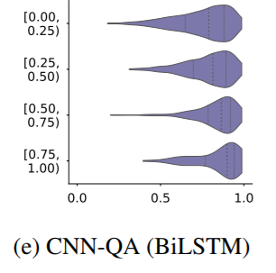
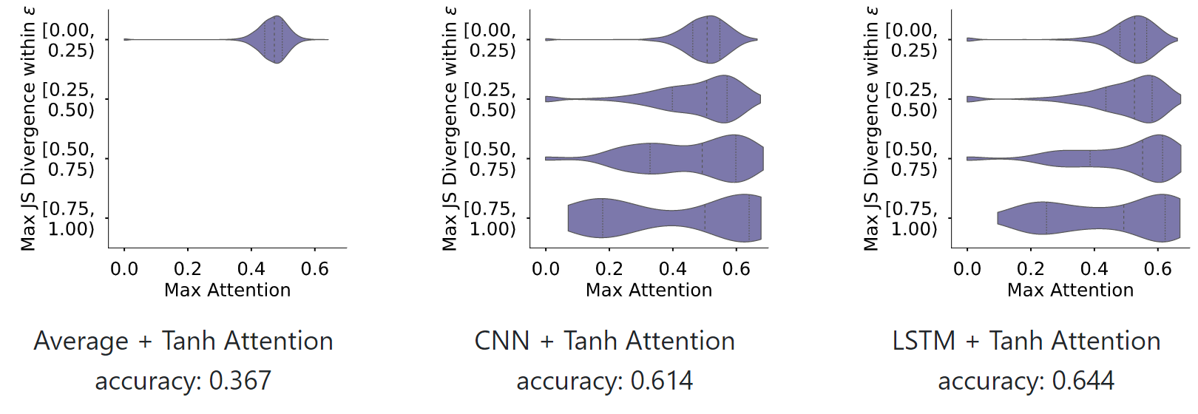
Existence does not Entail Exclusivity
when we consider that most tasks selected by J&W are binary, the experimental setting maps into a vast amount of model freedom: aggregating 180 scalars (the average length of an IMDb instance) to a desired prediction scalar in the (-1,1) range cannot be expected to be a difficult task when no other constraints exist.
Indeed, the most open-ended task, QA over CNN data, produces considerable difficulty to manipulate its scores by random permutation (Figure 3f in the paper).
Similarly, the adversarial examples presented in Appendix C for the QA datasets select an incorrect token instance of the correct type (garden, entity13), which should not surprise us given that the underlying model is an LSTM — encoder hidden states are typically affected by the input word to a noticeable degree.

Slide 23
Attention Distribution is not a Primitive
Given all this, if we use attention scores to explain to a user why a model picked a certain token, shouldn’t we be glad that despite being able to reach the same prediction by giving a high weight to a different token with the same type, the attention mechanism managed to focus on the correct instance?
Detaching the attention scores obtained by parts of the model (i.e. the attention mechanism) degrades the model itself.
The attention weights were computed by an integral component whose parameters were trained alongside the rest of the layers. J&W provide alternative distributions which may result in similar predictions, but in the process they remove the very linkage by which attention modelers motivate the explainability of these distributions, namely the fact that the model was trained to attend to the tokens it chose.

Slide 24
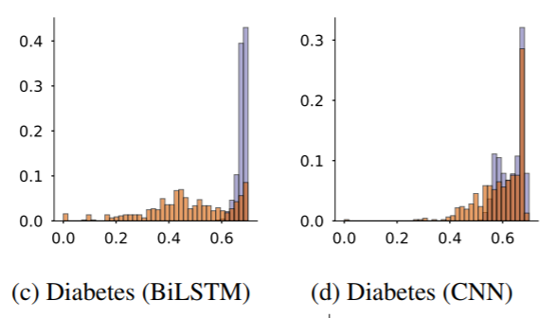
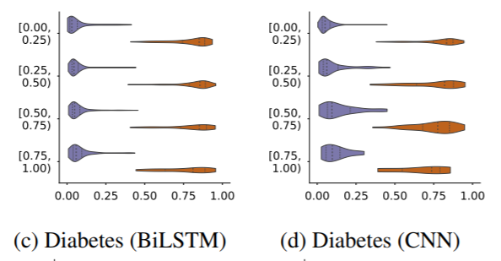
Not all Labels are Alike.
Diabetes (Figures 3c-d, 4c-d) : the positive-label instances are very hard to manipulate, whereas the negative-label ones are not.
This behavior emerges from the nature of a true 0–1 task: the presence of diabetes is likely to be described using a short phrase or several domain-salient words, but its absence is likely not to be mentioned at all, rendering any part of the document as (non-)informative as the rest, and thus allowing many alternative distributions to be as useful as the original one.

Slide 25
Explanation is not Explanation
Attention as a sanity check: we, who built the (say) translation model, have an idea which words in the source text “should” map to which words in the target text
Attention as a tool: the model is looking at (say) the patient visit summary, predicting which condition was diagnosed (supervised by existing annotation), and tells us through attention which part of the text caused it to make the prediction.

Slide 26
Reply from the authors
For example, a movie review “This movie was terrible … the acting was bad” has at least two different explanations that attention could reasonably focus on to come to the same disposition.
In our view, a faithful explanation should highlight both of these as important snippets. However, consider that for transparency, if multiple disjoint snippets are responsible for a prediction but the model only highlights one, this may be quite misleading.
https://medium.com/@successar/some-clarifications-regarding-attention-is-not-explanation-106345dc818e

Slide 27
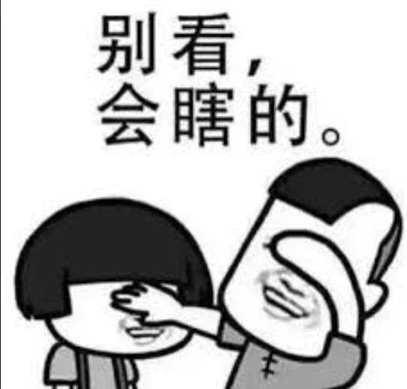
Summary
不看觉得不好，看了之后懵逼。。
似乎有道理，想想没道理，再想想有点道理又不是很有道理。。。
内容配不上标题，需要更多实验验证。
可能有抛砖引玉的作用。
我亲身看了。。。给大家排雷。。。
看的两天我眼睛都要瞎了。。。
好像是印度人。。整篇文章都是定语从句。。
To which, to which, to xxx….
Oh~~~~~~

